Slide 1
Combining Local and Global Planner for effective navigation in Indoor Spaces
Presented by:
Akshata S Pore
Kavit N Shah
Soumya S Balijepally
Notes:
Hello everyone today well be talking about our project which is Combining a local and a global planner for an effective navigation in indoor dynamic environments.

Slide 2
Objectives
Find a path in a dynamic environment with fusion of local planning algorithm as RRT* and global planning algorithm as A*.
Find an optimal global path connecting start and end points using A*
Sample points around the dynamic obstacle when detected and plan a path around the obstacle using RRT*.
Connect the path generated by A* and RRT*
Create a package in ROS and embed the package in Turtle Bot and simulate in Gazebo
Of the Project
Notes:
So the objectives of this project is to find a path in a dynamic environment by combining the A* and the RRT* algorithm with A* as the global planner and the RRT* as a local planner. So the path found by the global planner is optimal and when there is an obstacle we use a local planner toplan a path effectivly avoiding the collision with the obstacle. While creating a ROS packing and building a navigation stack.

Slide 3
Motivation:
Harness advantages of both and at the same time avoiding disadvantages of each other.
An approach to make best use of existing algorithms to perform in environments with dynamic obstacles.
Obtain an improved speed and optimality as opposed to using each one individually
What is the need of combining both the algorithms?
Notes:
Why do we have to combine the two algorithms ? The main reason of combing the two algorithm is to get the best of both algorithms and also avoiding the disadvantages of the both. The A* algorithm is used to find the most optimal path and if an obstacle observed in the path it would be avoided by a quick replainning of a detour path around the obstacle by the local planner. This would work well with dynamic obstacles and as a result we would obtain a optimal path and at the same time a quick path is replanned in case of obsatcles.

Slide 4
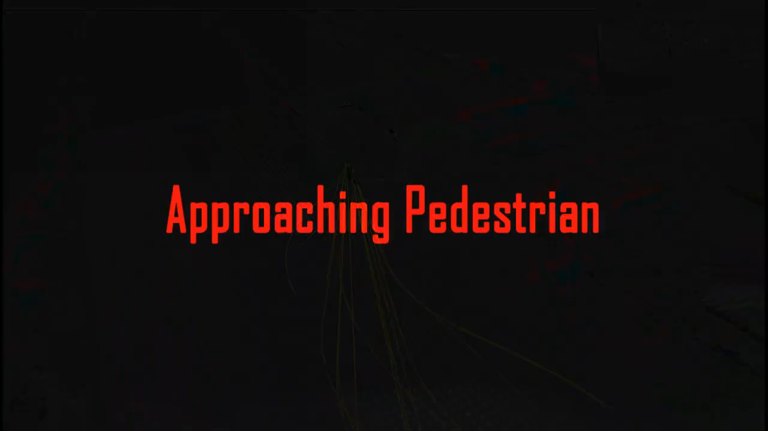

Motivation:
Implementation of APF as a global planner with RRT* as a local planner for dynamic obstacles detection.
Notes:
This idea of combining two algorithms has been implimented in the past here in the senario of autonomous driving, here Artifical potential field has been implimented as a global planner and the RRT* algorithm has been used as a local planner for quick replanning.

Slide 5
Related Research
1. Connell 2017.
This paper proposes a novel framework of using RRT* as a global planner to compute the high-level route avoiding static obstacles and again uses RRT* as a local planner to avoid dynamic obstacles as and when they appear.
It also considers non-moving as well a moving dynamic obstacles and proposes a condition to determine if there is a need to re-plan if in case encountered a dynamic obstacle.
This algorithm is probabilistically complete
Background work done for the project
Notes:
Moving on to the related research this paper implimentes RRT* both as a global and a local planner for navigation in a dynamic environment. This algorithm is probabistically complete.

Slide 6
Related Research
2. Hwangbo 2007.
This paper highlights the importance of following trajectories differently at global and local levels rather than following on the same trajectory.
It generates a high-level path globally avoiding obstacles and then uses smoothed splines to generate trajectories on a local level.
They have implemented this algorithm for UAVs moving through loops.
continued
Notes:
This paper emphasizes on the ieda of following different trajectories at the global and the local level. Here the global path is for for avoiding the obstacles whereas the local planner uses the smoothened splines to generate trajectories.

Slide 7
Related Research
3. Bohlin 2001.
This paper uses A* as a global planner to generate a high-level path and again uses A* as a local planner to avoid dynamic obstacle locally.
It uses a coarse grid of the map to generate a high-level path and successively refines the grid for generating optimal path locally avoiding dynamic obstacles.
It is complete and optimal in finding the best route
The disadvantage of increased computational space for refining the grid is also evident.
continued
Notes:
This paper uses A* as a global and a local planner first to plan a path between the start and goal and then the local version to avoid obstacles that are dynamic. This algorithm is complete and optimal but it is costly in terms of space.

Slide 8
Related Research
4. Qureshi 2013.
The paper introduces a framework to reduce the processing time by incorporating Artificial Potential Fields Algorithm into RRT*as it directs the random samples toward the goal thus increasing the speed of RRT*.
Potential Guided Directional-RRT*: Artificial Potential Fields directionalize the random samples in the direction of decreasing potential leading to lesser dispersion of samples in configuration space which then provides a solution compared to RRT*.
Potential Guided Directional-RRT* is highly efficient in different environment as it reduces number of iterations and hence reducing the amount of time needed to compute a more optimal solution as compared to RRT*
continued
Notes:
This paper aims to reduce the processing time by including Artificial Potential Field into t he RRT* there the APF directionlizes the Samples so there is a lesser dispersion of the samples and RRt* samples from those samples making it fasted.

Slide 9
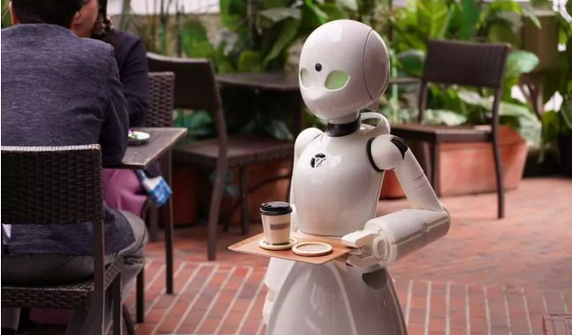
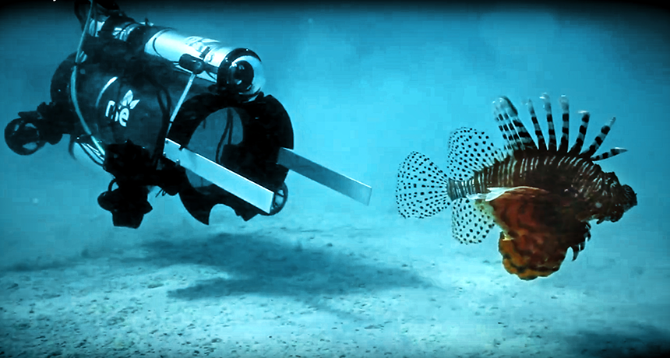
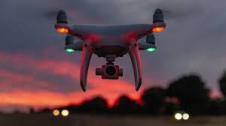
Related work review
Notes:
Robots can augment the ability of human to perform variety of tasks. Here we analyze robots that depend on Human instructions to perform tasks. Such robots can be broadly classified into aerial, ground and underwater robots. Examples of such robots on ground can be teleoperation robots, domestic assistant, shopping cart robots, etc. Diver-following robots are useful in the submarine pipeline and shipwreck inspection, marine
life and seabed monitoring, and many other underwater exploration activities. Quadcopters have become quite popular for filming outdoor activities such as mountain climbing, biking, surfing, and many other sporting endeavors.

Slide 10
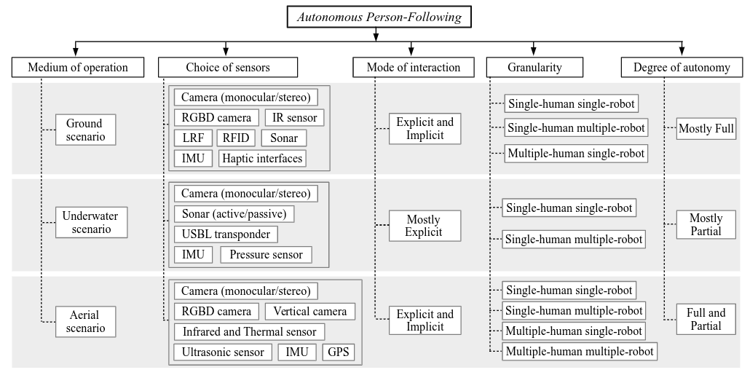
Related work review: Important Aspects
Notes:
So while designing such robots, we have to take into consideration certain important factors. Some of these factors are listed above. Obviously each of each factors differs in different environment depending on the complexity that the environment offers. Taking look at sensors, for ground applications we need both image perception sensors and distance measurement sensors like sonar. Fusion of Multiple sensors is generally used for correct estimation and to reduce uncertainty. For underwater, generally cameras are used but due to challenging marine condition, depth measurement sensors are also used. For aerial scenario, generally distance is calculated using vision sensors generally. Explicit mode of interaction means direct interaction between human and robot whereas implicit means indirect. On ground both implicit and explicit are viable. But for underwater, direct interaction is preferred wherein the robot performs actions based on human commands like collecting samples, taking photos, etc. For aerial, it can be both. Granularity means no of humans and robots involved. In underwater, due to complexities in the environment, only single human will lead robot or groups of robot.

Slide 11
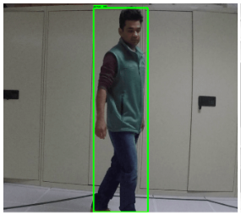
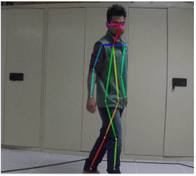
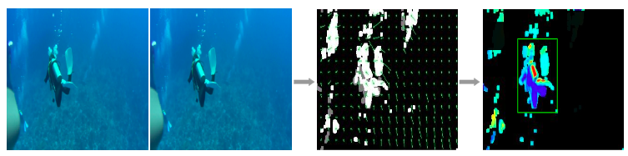
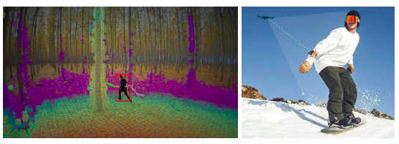
Related work review: State of Art Methods
Perception of Ground based robots
Feature Based Tracking
Feature Based Learning
Feature or Representation Learning
Perception of Underwater based robots
Must be robust
Limited on-boarding resources
Color based tracking
Perception of Aerial Robots
Notes:
Perception plays a major role in design of robots. For robots related to ground , perception is mainly divided into three parts as shown. For feature based tracking, features refers to a specific pattern in terms of shape, average distance, and the number of points in the 3D point-cloud. Since searching of the entire feature space can be computationally expensive, making prior guesses is always handy. Feature based learning approximates the function that relates the input feature space to the exact location of the person is used , using machine learning techniques to approximate that function . In underwaster scenario, perform binary image thresholding based on the color of the diver’s flippers or suit. The binary image is then refined to track the centroid of the target (diver) using algorithms. For aerial robots, standard feature based tracking can be used. Apart from that, More reliable sensing and robust tracking performance can be achieved by using an additional depth sensor.

Slide 12
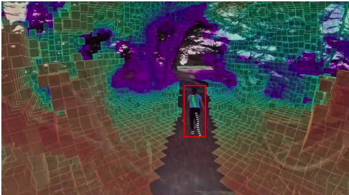
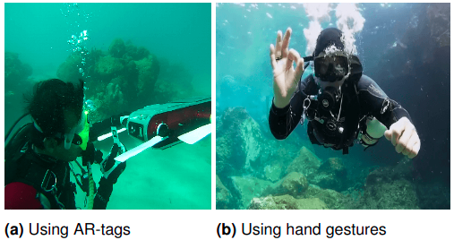
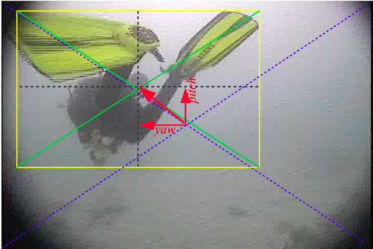
Related work review: State of Art Methods
Planning
Map-assisted vs Target-centric Planning
Planning for Position-based Servoing
Planning for Image-based Servoing
Interaction
Explicit Interaction
Implicit Interaction
Spatial conduct
Appearance and gaze conduct
Motion Conduct
Notes:
Map-assisted planning is feasible for structured environments with a known map, particularly for person-following ground robots in indoor settings. Although a global map can significantly simplify the planning and navigation processes, it is usually not available in outdoor applications. In such cases, a target-centric approach is adopted. First, the locally sensed information is used to create a partial map of the environment; traditional SLAM-based techniques are most commonly used for this purpose. For position based approach, path planner finds the optimal path to follow a target using its estimated position with respect to the robot. It is to be noted that this planning can be either map-assisted or target-centric, depending on whether or not the global mapping information is available.
Explicit interactions happen when there are direct communications between the human and the robot. Verbal communication wherein person directly gives voice commands to the robot is widely used. Underwater robots, uses Tags or fiducial markers wherein different sequences of symbolic patterns of those markers are mapped to a set of grammar rules. Spatial conduct consists of a set of desired proxemic behaviors of a robot while following a person in an HRI setting.
The companion human’s gaze behavior is an important feature to track in order to predict their motion. Additionally, it helps the robot to identify when the person is about to start an explicit interaction and to plan accordingly, e.g. , slow down or stop, prepare to detect and interpret the communicated instructions, etc.
The expected motion behavior of the robot when its human companion is interacting with other people or goes out of its sight are important design considerations

Slide 13
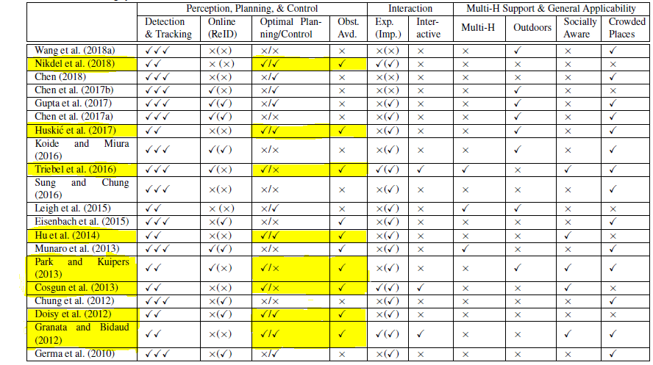
Related work review
Qualitative Analysis:
Notes:
For the purpose of brevity we would be talking about unmaned ground vehicles this table represents A set of qualitative comparisons is presented among a number of prominent person-following systems reported over the last decade. The rows highlighted represents papers relevent to motion planning that have path planning algorithms that Optimal Planning optimality of the underlying planning and control modules, (iv) Obst. Avd.: presence of obstacle avoidance features.

Slide 14
Prospective Research Directions
Tracking a team of independently moving objects.
following a group of people by a team of autonomous robots.
Robots following or leading or walking side by side?
Learning to Follow from Demonstration.
Human-Robot Communication.
Enabling Social and Spatial Awareness
Long-term Interaction and Support
Specific Person-Following.
Surveillance and Rescue Support
Addressing Privacy and Safety Concerns
Notes:
The following subsections discuss a number of active research areas and open problems that are naturally challenging and are potentially useful in person-following applications. P3:In recent years, researchers have begun to explore the particularities of different scenarios (Figure 19) where the robot should be in front or on the side of the person while following (Hu et al., 2014; Ferrer et al., 2013; Nagy and Vaughan, 2017). These scenarios impart more operational challenges since the robot needs to predict the motion trajectory of the person
P5: Human robot interaction P6: learning social noms n all that P6: mostly with surgcal robots for theraputic purposes.

Slide 15
Requirements for a global and a local planner
Requirements from the global planner
Given the discretized map of workspace as input, should give a path quickly.
The path should be optimal.
Not much computation.
Requirements from the local planner
Should be quick.
No need for an optimal path.
Should be at some clearance from the obstacle to avoid collision.
Why are A* and RRT* used as global and Local planners
Notes:
Till now weve seen that in many papers have pitched on the idea of combining two algorithms for dynamic path planning what would be the local and the global planner for a global planner we need a quick and an optimal path and the requirements of a local planner are thata it should be really quick replanning and and computationally effciency is need and the path does not have to be optimal just quick in avoiding obstacles. Hence weve used A* as a global planner and RRT* as a local planner.

Slide 16
Assumptions
A discretized map of the space is already obtained.
We assume that the speed of the obstacle is less than the computation speed of RRT*
The global path is calculated using A* this being the optimal path would be followed by the robot after avoiding the obstacle.
That have been made for the project
Notes:
Before we move on to the implimentation and the realtime approach to the project lets disscuss breifly about the assumptions made in the project
1. The first assumption is that we already have a discritized map of the C-space.
2. Secondly, we are assuming that the computation speed of the RRT* is faster than that of the obstacles. So that means that the obstacle seems stationary.
3. third and the last is that the global path calculated by the A* is optimal and it is gonna be followed by the robot after avoiding the obstacle.

Slide 17
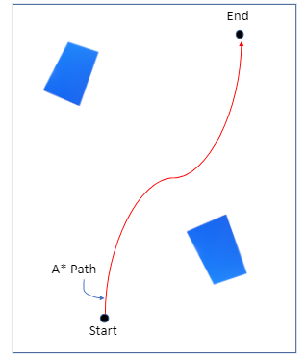
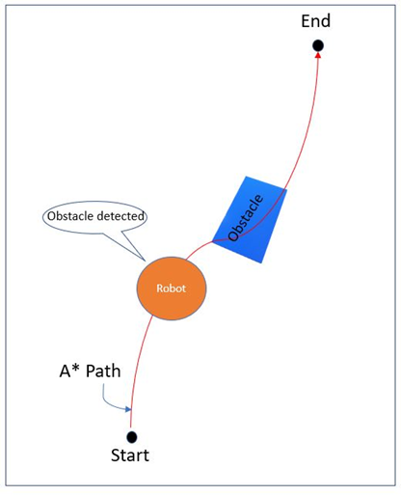
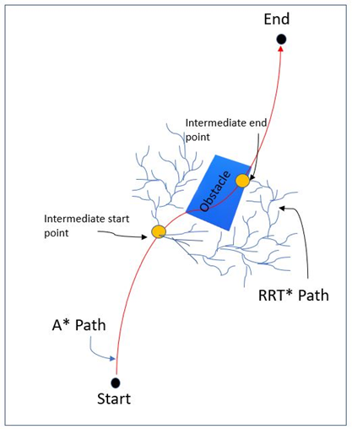
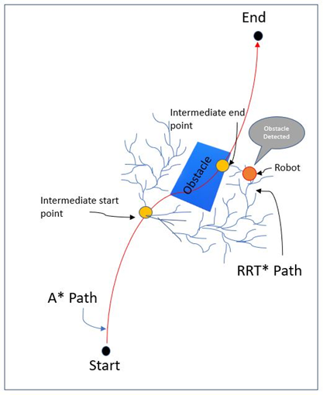
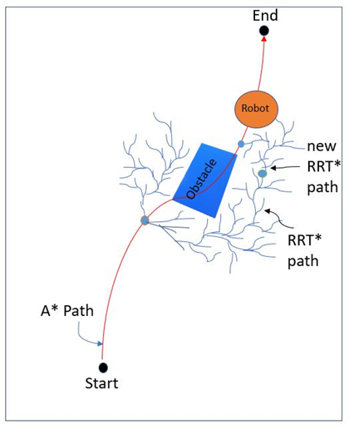
Approach
Find a path from start to goal with A*.
In the presence of an obstacle use RRT*
Using the RRT* a path is found between intermediate start and goal
If the goal point is not free space RRT* will replan the path towards a new intermediate goal.
On reaching the intermediate goal algorithm switchs to A*.
Notes:
Moving on to the specifics of the approach that is used so,
First, a path is found by the A* from the start to the goal and the robot moves towards the goal in that path.
Now using laser imaging the robot figures out that there is an obstacle in the path. Then the robot switches to the RRT* to avoid collision.
So now using the RRT* a quick replanning is done beteen an intermediate start and goal.
Now there can be two senarios 1. if there is an obstacle at the itermediate goal RRT* is recomputed to avoid it and 2. there is no obstacle at the goal the robot moves to the intermediate goal and then switchs to the original A* path to go from the intermediate goal to the final goal.

Slide 18
Experiment:
Build the A* algorithm on an already available map
Use Laser Imaging for building a Realtime local map for the RRT*
Build the RRT* algorithm on the image obtained from the Laser Imaging
Build a ROS package.
Build a controller for the Turtlebot
Evaluate the Algorithm with another algorithm.
Intigrate the A* and the RRT* algorithm
Building a ROS Navigation stack
Notes:
Coming to the implimentation of the project.The flowchart on the slides gives the step by step implimentation of the project. We aim to build a navigation stack for the turtlebot. There we already have the discritized map of the space and the A* has been computed on that map. Using Laser imaging the obstacle is found in the C space and then RRT* has been computed on the map obtained by laser imaging. For the turtlebot to move in the desired path in the environment a controller has been implimented. Then we intigrate the A* and the RRT* algorithm and we evaluate the perfomace of the navigation stack by comapring its perfomance with other algorithms.

Slide 19
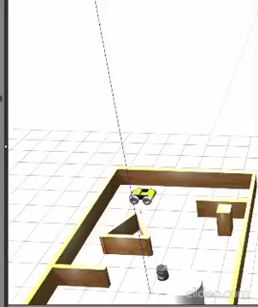
Result:
The A* Algorithm in Action!
Creates a grid based discretization of the world.
Once initialized, it gets the current position and starts calculating neighbors
Checks whether the neighbors lie in obstacle region based on occupancy grid map or have been checked before
Valid neighbors are added to list
All valid nodes are checked and then the optimal path is calculated

Slide 20
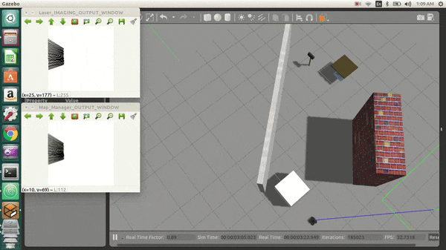
Result:
Laser Imaging
At each instant, takes a 360 scan of the local environment.
Converts the local scan into image using image processing
The robot is at the center of each image
Each obstacle is then represented on image using Bresenham’s line algorithm
Notes:
For the implimentation of laser imaging an LDS 360 has been attached to t he turtlebot. Each scan has a value and we have set the treshold value to 4X4 m so if the scan value is grater than 4 there is no obstacle present and if there is an obstacle present the value is lesser than 4. Bresenhams algorithm is used to sketch lines there lines are black where the obstacles are present and white otherwise for every scan the imgae is updated so that its not overlapped opencv bridge is used to conver the \opencv image to a ros message and publish it. The results are shown in the slide.
This image is then used by the RRT* node which samples points from this REAL-TIME MAP-IMAGE of the LOCAL IMMEDIATE ROBOT Env.

Slide 21
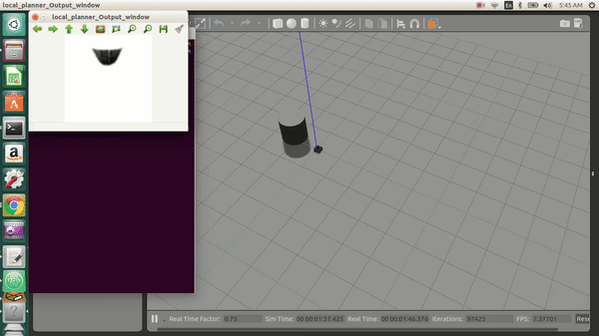
Results:
RRT* in Action!
Initialized once a dynamic obstacle blocks robot’s path
It samples points in the image and tries to generate a path towards the goal
The goal is the state after 4 points from the current state on global path
Avoids dynamic obstacles to again merge with the global path

Slide 22
Work done and Work to do:
Work completed:
Developed the A* Algorithm and successfully ran it on the Turtlebot in Gazebo.
Built a map using laser imaging for the RRT* to work.
Developed the RRT* algorithm and ran it successfully on Turtlebot in Gazebo.
Built a controller for the turtlebot's navigation.
Built a ROS package.
Work to do:
Combine the A* and the RRT* algorithm.
Evaluate the performance of the Algorithm with other algorithms.
Till the date of 5/7/2020
Notes:
The work done upto now includes the development of the A* and the implimentiaon of this algorithm on the turtlebot. Used laser imaging to build a map in order to avoid obstacles in the environment and them implimented the RRT* algorithm on the map and ran it successfully using the controller to move the turtlebot in the environment. We have been intigrating the A* and RRT* algorithm and strive to succesfully finish it. We have also the perfomace evalution of the algorithm.

Slide 23
References
Connell, Devin, and Hung Manh La. "Dynamic path planning and replanning for mobile robots using RRT*." 2017 IEEE International Conference on Systems, Man, and Cybernetics (SMC). IEEE, 2017.
Hwangbo, Myung, James Kuffner, and Takeo Kanade. "Efficient two-phase 3D motion planning for small fixed-wing UAVs." Proceedings 2007 IEEE International Conference on Robotics and Automation. IEEE, 2007.
Bohlin, Robert. "Path planning in practice; lazy evaluation on a multi-resolution grid." Proceedings 2001 IEEE/RSJ International Conference on Intelligent Robots and Systems. Expanding the Societal Role of Robotics in the the Next Millennium (Cat. No. 01CH37180). Vol. 1. IEEE, 2001.
Qureshi, Ahmed Hussain, et al. "Potential guided directional-RRT* for accelerated motion planning in cluttered environments." 2013 IEEE International Conference on Mechatronics and Automation. IEEE, 2013.
References used for the project.
Notes:
These are the references of the project.

Slide 24
References
Otte, Michael, and Emilio Frazzoli. "RRTX: Asymptotically optimal single-query sampling-based motion planning with quick replanning." The International Journal of Robotics Research 35.7 (2016): 797-822.
Islam, Md Jahidul, Jungseok Hong, and Junaed Sattar. "Person-following by autonomous robots: A categorical overview." The International Journal of Robotics Research 38.14 (2019): 1581-1618
Huski´c G, Buck S, Gonz´alez LAI and Zell A (2017) Outdoor PersonFollowing at Higher Speeds Using a Skid-steered MobileRobot. In: IEEE/RSJ International Conference on IntelligentRobots and Systems (IROS). IEEE, pp. 3433–3438.
Hu JS, Wang JJ and Ho DM (2014) Design of Sensing System and Anticipative Behavior for Human Following Mobile Robots. IEEE Transactions on Industrial Electronics 61(4):1916–1927.
Continued:

Slide 25
References
Doisy G, Jevtic A, Lucet E and Edan Y (2012) Adaptive Personfollowing Algorithm Based on Depth Images and Mapping. In: IROS Workshop on Robot Motion Planning.
Granata C and Bidaud P (2012) A Framework for the Design of Person Following Behaviors for Social Mobile Robots. In: IEEE/RSJ International Conference on Intelligent Robots and Systems (IROS). IEEE, pp. 4652–4659.
Continued:

Slide 26
Thank you

